Slide 1



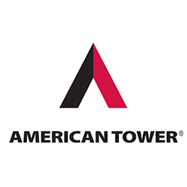

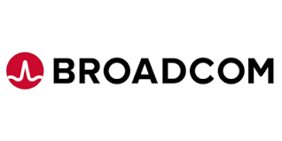

5G TECHNOLOGY Stock Analysis
US companies better positioned for 5G technology implementation.
Author: Ulisses Pinto

Slide 2
Motivation & Objective
Recent surge of news surrounding the 5G technology and its potential to accommodate more than ten billion connected devices around the world.
Several tech companies such Apple, Google and Tesla in advanced development stage as the Internet of Things (IoT) becomes a reality.
The Covid-19 pandemic has accelerated the process of digitalization increasing the volume of people connected to the internet increasing consequently the data traffic.
The objective is to analyze historical data of stocks performance and trends to narrow down to 3 stocks and then find out the stock with the best expected risk x return performance. Also, provide a tool that would allow small investors to easily compare stocks through visualizations and help with the decision-making process.
1
This project has been motivated by 3 factors:
2
3

Slide 3

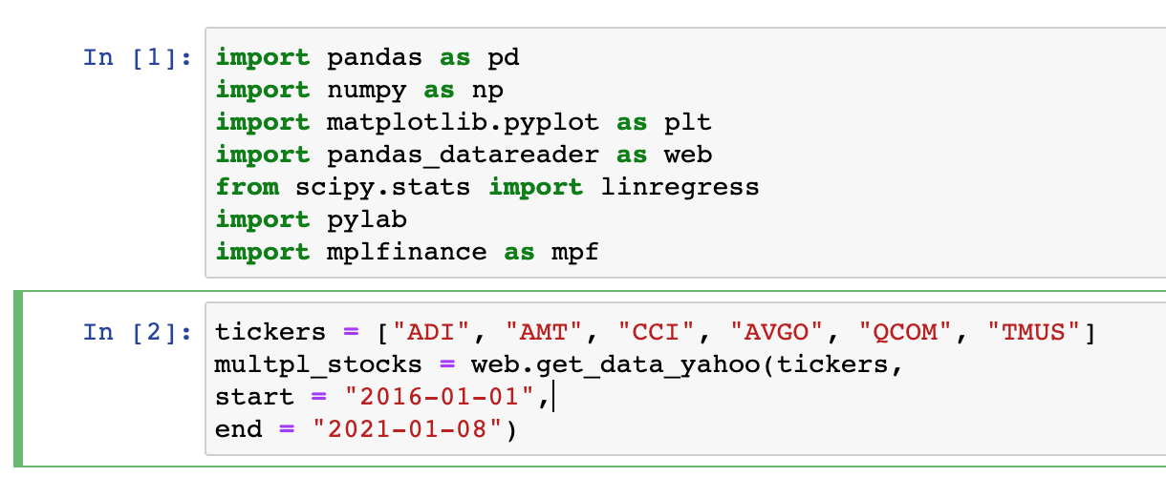
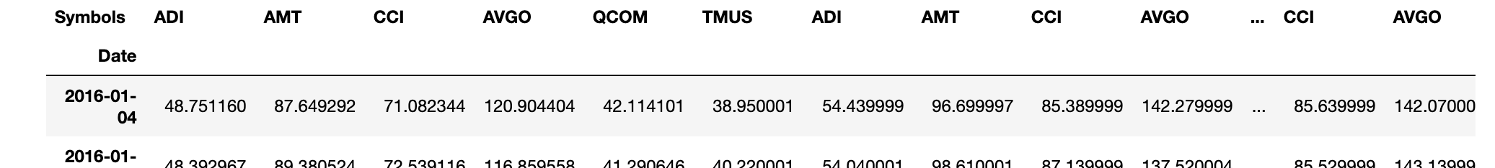
Data Extraction & Exploration
The process to collect data from yahoo/finance has been done through Python and pandas_datareader library using ticker to filter and collect specific data.
This library return a DataFrame that can be easily used to iterate between tickers and dates providing a clean for exploration.

Slide 4
Analysis - Intro
This project is based on technical analysis of 6 stocks from the following companies mentioned in the article “7 Best 5G Stocks to Buy” :
T-Mobile Us Inc (TMUS)
Qualcomm, Inc (QCOM)
Analog Devices, Inc (ADI)
American Tower Corp (AMT)
Crown Castle International Corp (CCI)
Broadcom Inc (AVGO)
Disclaimer: All analysis expressed in this project are from personal research and experience of the author and are intended as personal material.

Slide 5
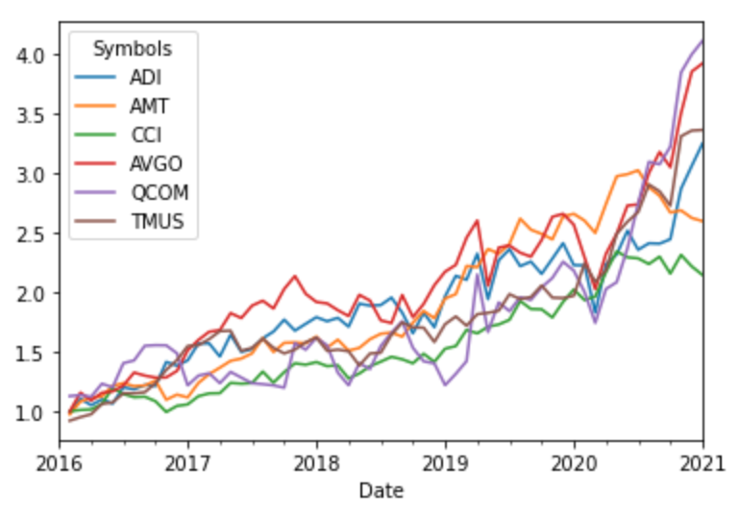
Historical Cumulative Return
This line chart provides a clear view of the cumulative return of all 6 stocks since 2016.
It is known that 5 years is a fair representation when it comes to stocks historical data analysis.

Slide 6
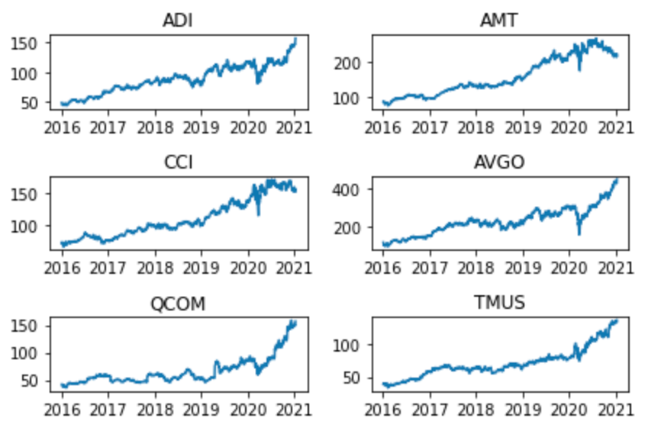
Analysis
The information seen in this series of chart provide an overview of the historical prices of each stock. It is possible to say at a glance that AMT and CCI does not follow the same pattern seen on all other 4 stocks. Both show similar trend of downturn at the beginning of 2020.
It is possible that those companies will not make to the next list of stocks with better performance, however, it is prudent that we have a deeper analyze to confirm.

Slide 7
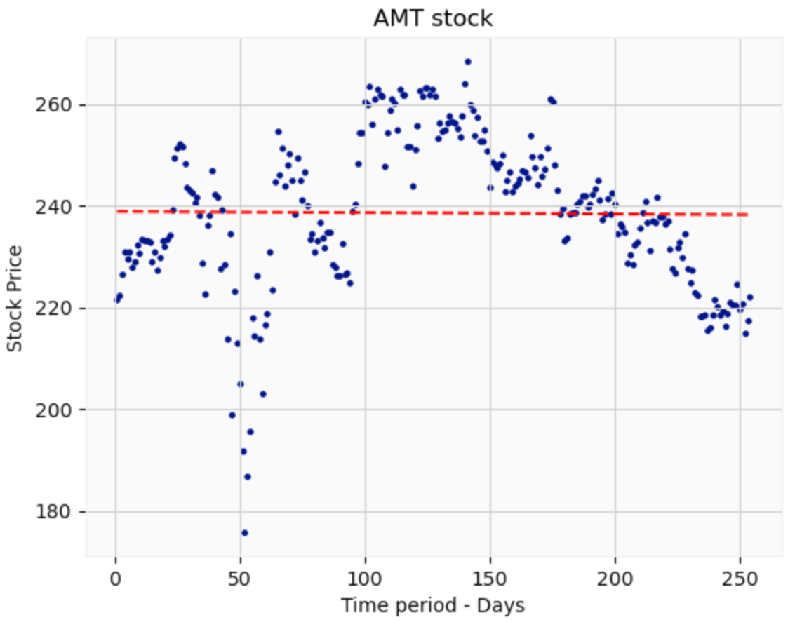
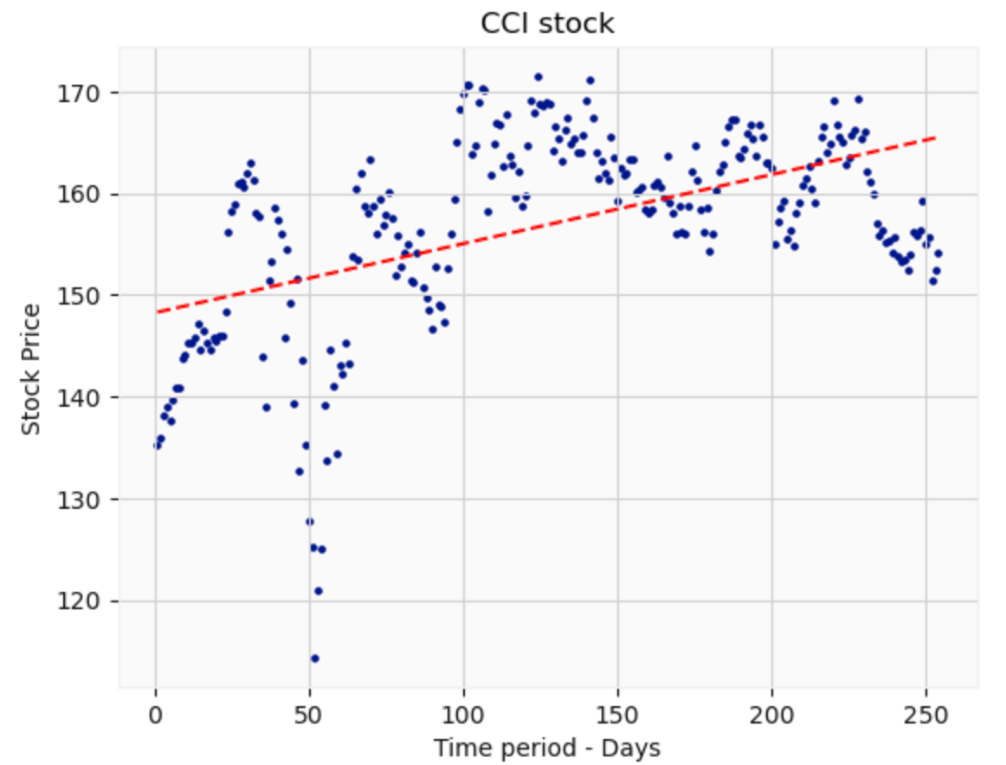
Analysis - Worst Performance
Here is a deeper analyze of the AMT and CCI stocks for the past 12 months. It is clear to see with the trendline that AMT stock performance does not show an upturn trend.
For CCI stock there is a positive trend, however it is a light upturn that does not confirm high likelihood for good performance due to the overall economic and political situation.

Slide 8
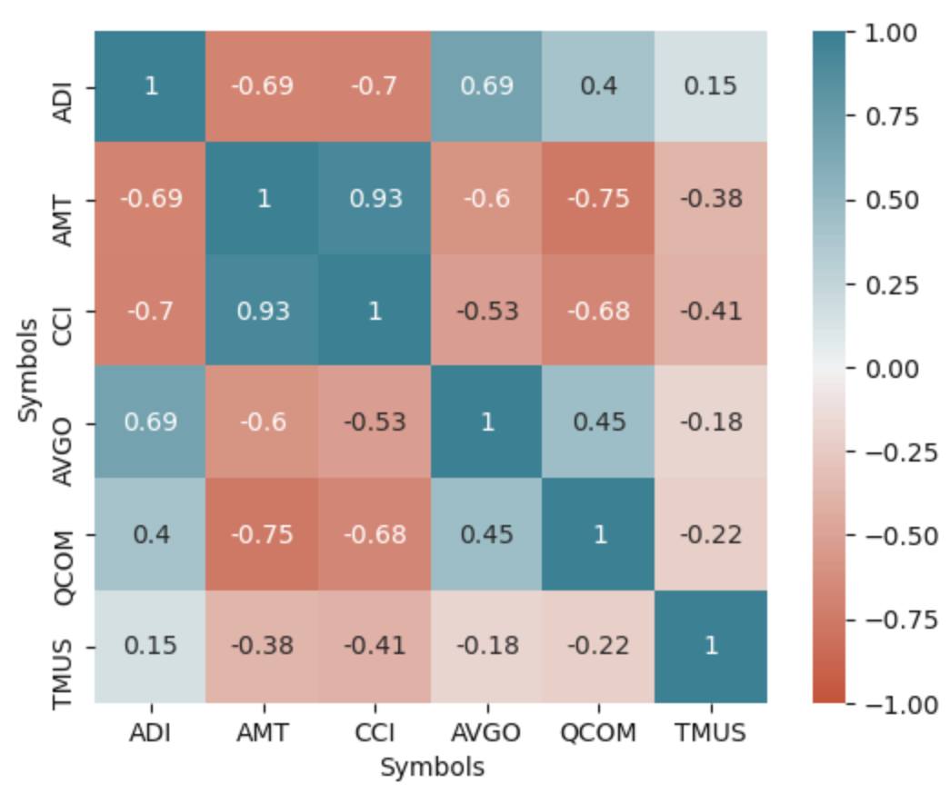
Analysis - Worst Performance
This graph represents how each of the stocks are correlated each other. Here is where the confirmation of the worst performance comes to the light with the AMT and CCI stocks presenting the highest positive correlation.
It might be due to the type of product or services these companies provide. It is not recommended to have these two stocks in the same portfolio if one’s is looking for diversification.

Slide 9
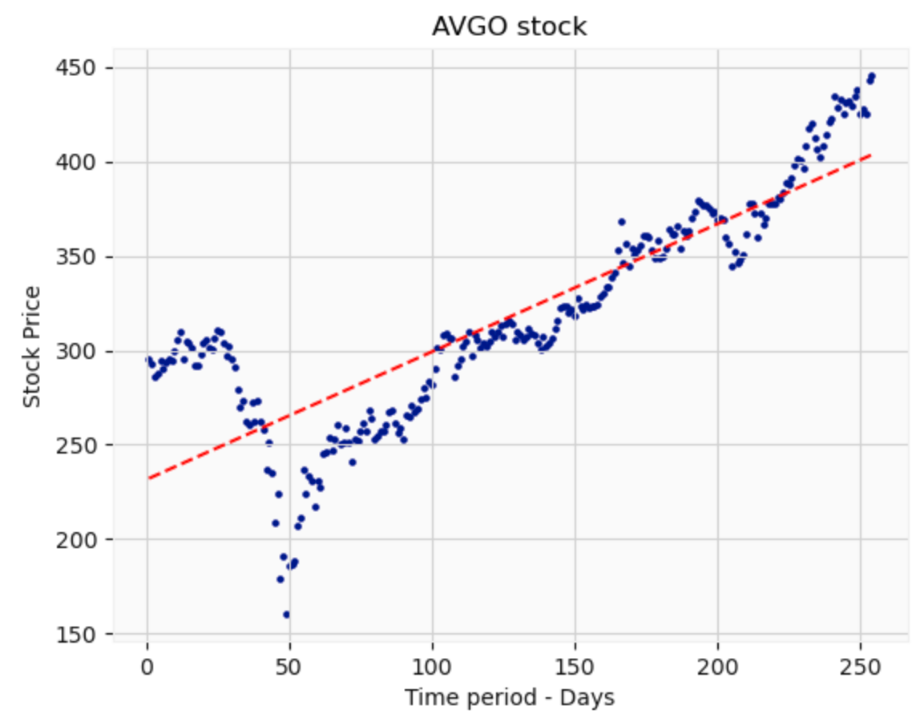
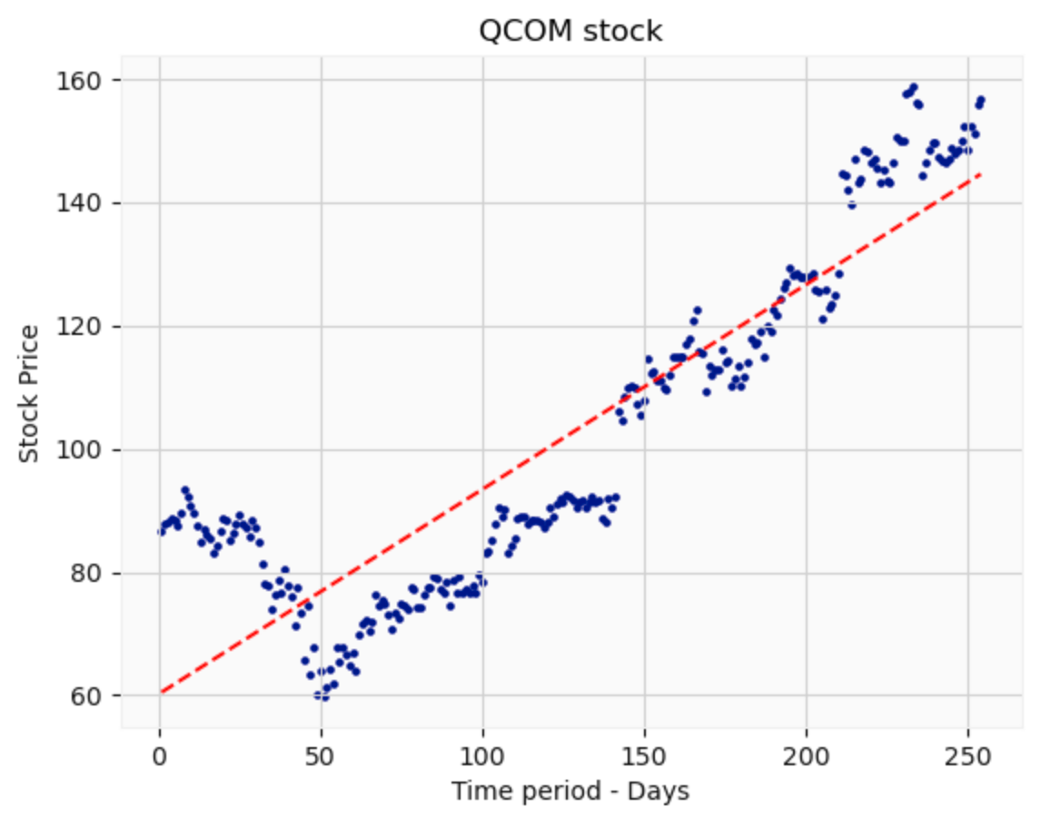
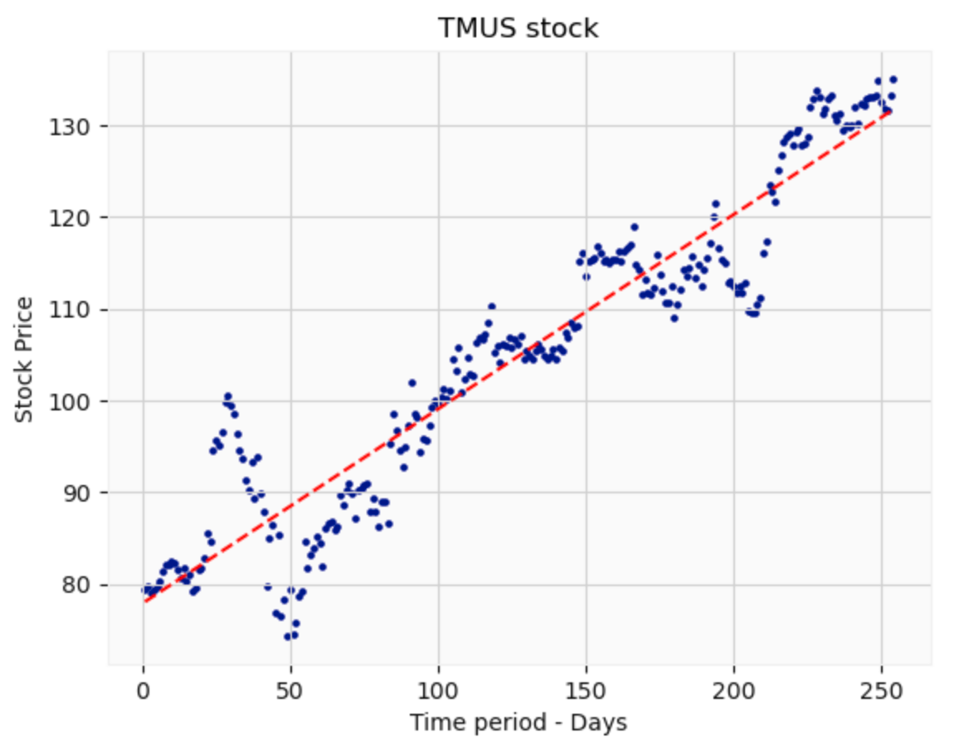
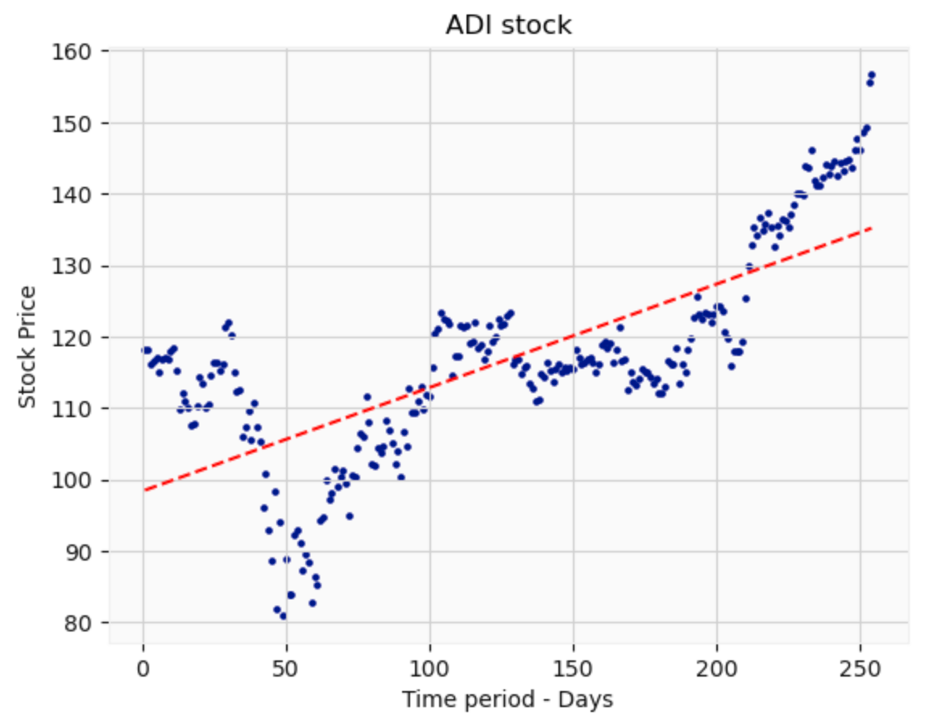
Analysis – Building the TOP 3
To form the Top 3 list, we will perform a side-by-side analysis to eliminate the one with the lower uptrend line. In this case by the visual we can see the ADI stock has the lower uptrend. Also, important to mention that the volatility of the stock looks higher among of all 4 stocks in the same period.
For this reason, the stock ADI will not be part of the Top 3 list.

Slide 10
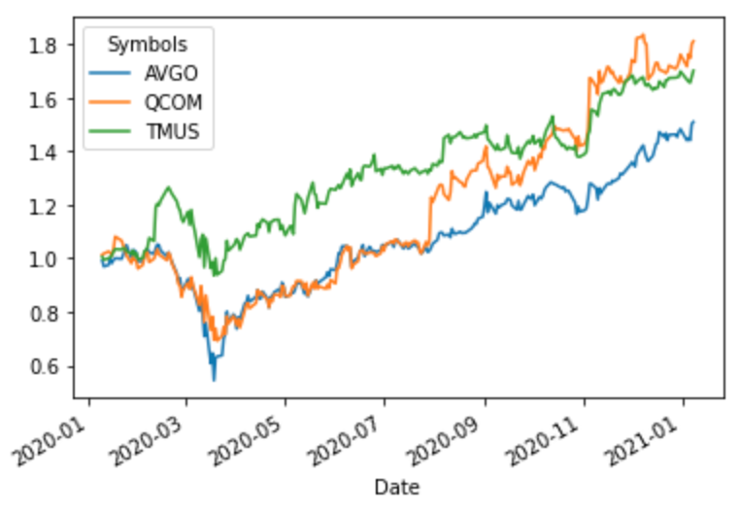
Top 3 Performance
Here is our top 3 performance list and its performance for the last 12 months.
From this chart we can clearly see the 2 COVID19 waves and how deep the stocks went in March and April. Interestingly these stocks has already recovered from the first and second wave. In fact, there is real gain in value for its shareholders.

Slide 11
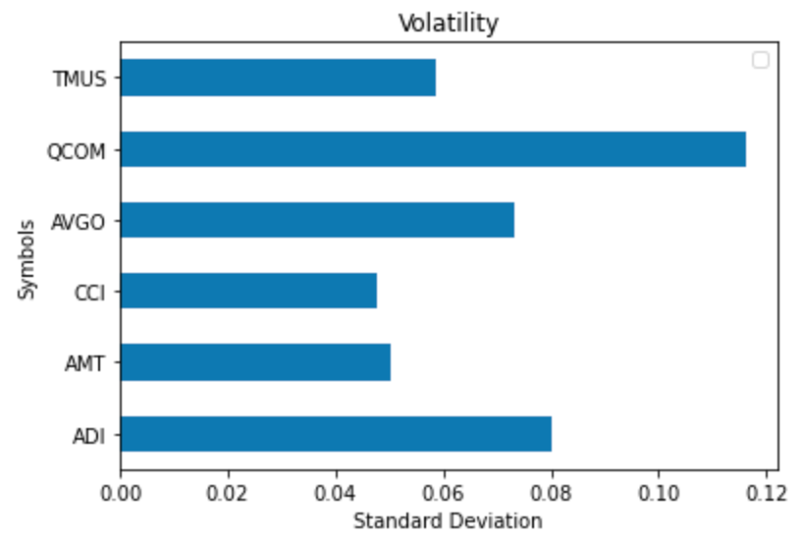
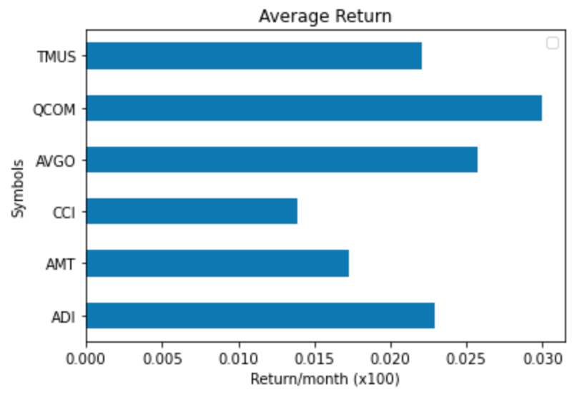
Now that we have defined our top 3, the next objective is to narrow it even further down to 1 stock. From now and on all the analysis are based on personal references of risk. It is known that a good measure of risk for a stock is its volatility.
For this project, the volatility is measured by the Standard Deviation. Return is very important; however, it is also important that the stocks align with one’s risk acceptance and the higher the Standard Deviation, the higher the risk.
Lower Risk
Higher Risk
Medium Risk

Slide 12
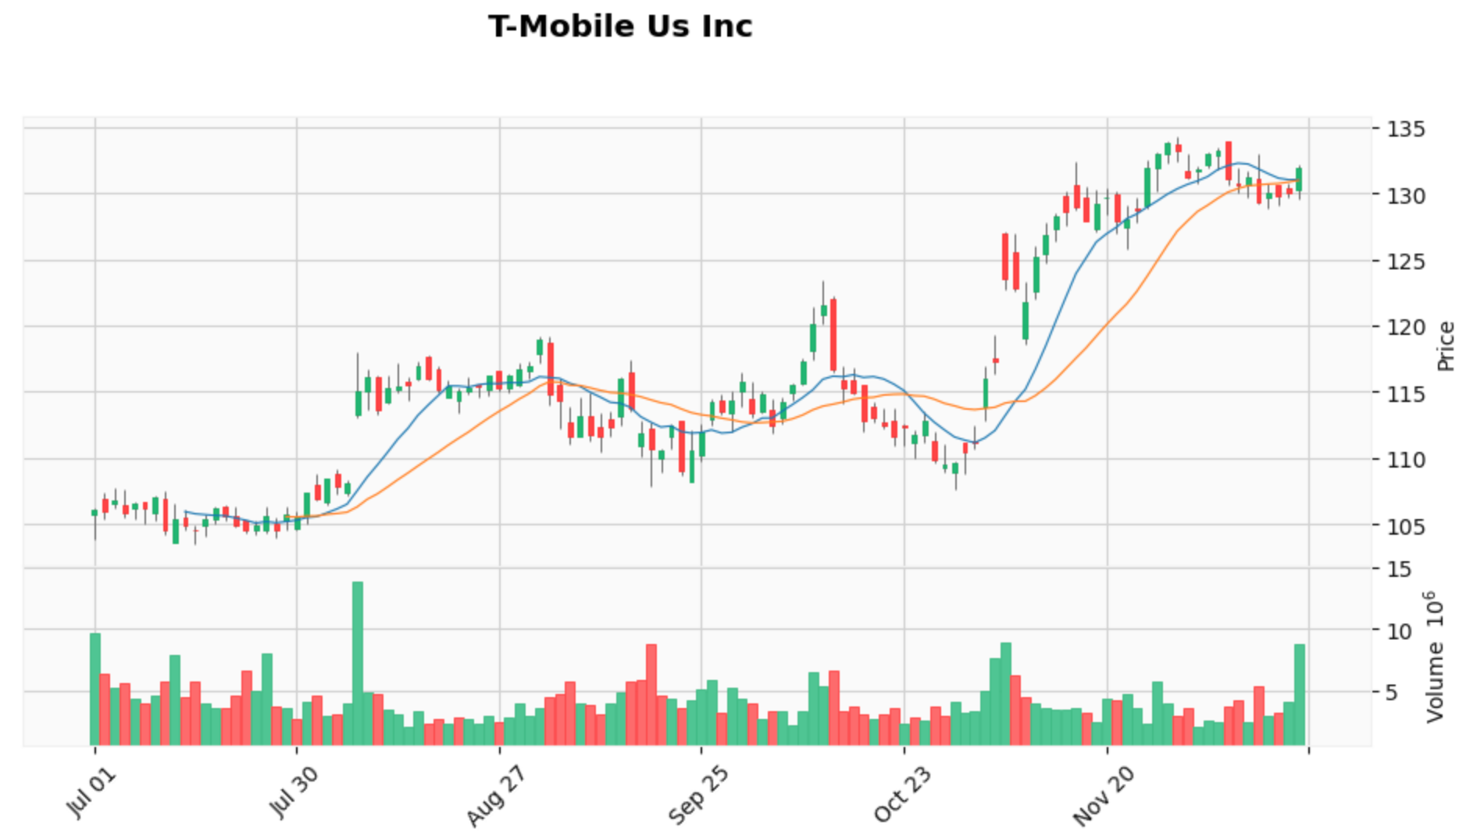
Best Stock Based on Risk x Return Performance
T-Mobile is the company with the best performance based on Risk x Return analysis.
The magenta line represents moments of resistance that varies from 2 to 3 months. Based on previous trends the stock is approaching the end of a resistance cycle which can be read as good moment to buy.
The stock also shows an incredible uptrend after a valley that represents the COVID19 second wave. It shows how strong is the momentum and definitely will be a good pick for one’s portfolio.

Slide 13

Conclusion
In this project we drilled down historical data for stock prices for those companies believed to have ready structure for 5G technology deployment.
It represents technical analysis, and it is still required a deeper look into indicators such as macroeconomics factors, state of the economy and the effectiveness of the company’s management.
Based on personal references of risk the company T-Mobile would definitely fit my portfolio, although the fundamental analysis is still to be addressed.

Slide 14
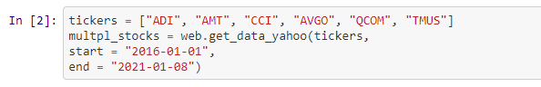
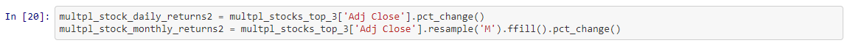
Bonus
Throughout the development process there was 2 main points the would be mandatory to achieve my objective. First: I want to create a solution for those who are not experts in Stock Exchange but want to get started, and in some way add value to someone's life. Second: The solution should be as automated as possible to analyze any stock.
The image above highlights the stock tickers and the start/end date. By changing any of these variables, all graphs and tables will also change accordingly providing the automation that I was looking for. Furthermore, the analysis can be done with more than 6 stocks, although it is recommended less than 10 for visual purposes.
The image below shows that the application is also ready for analysis in a monthly or daily basis. This is important because if there is a need to analyze certain stock for the last 45 days, the daily analysis will make more sense.
Thank you!

